Slide 1

#LifeKoKaroLift
Android

Slide 2


Course : Android
Lecture On : Services, Broadcast & Data Storage I
Instructor : Rohit Jain

Slide 3
In the last class we covered…
Notifications (continue)
View Pager

Slide 4
Today’s Agenda
Services
Broadcast Receivers

Slide 5
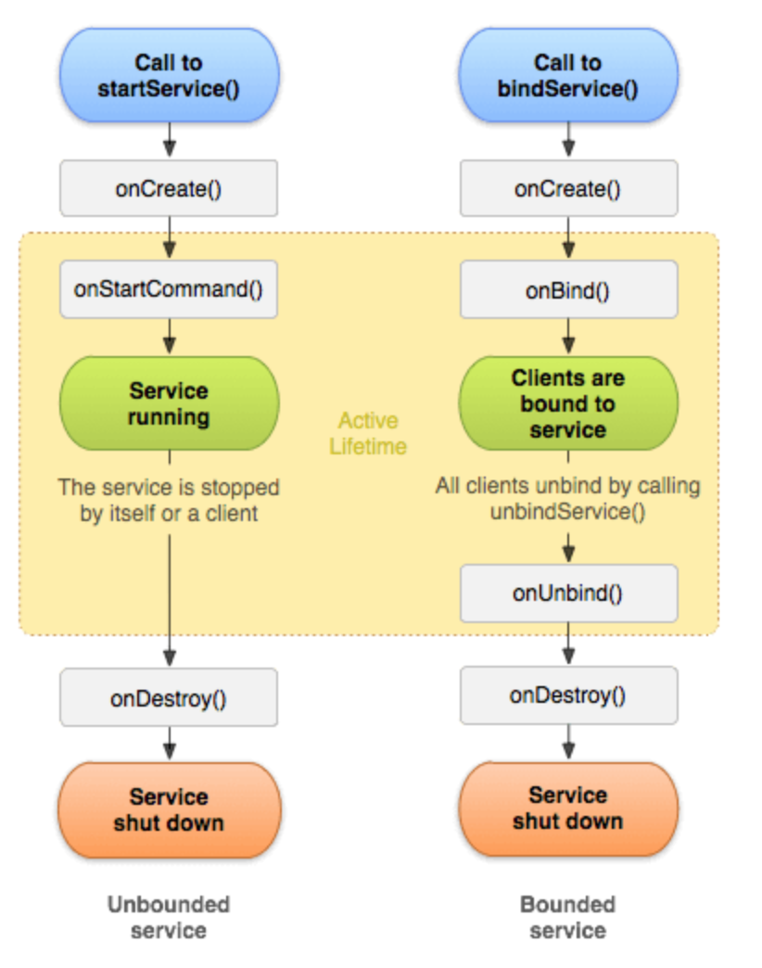
Service
Android service is a component that is used to perform operations on the background such as playing music, handle network transactions, interacting content providers etc. It doesn't has any UI (user interface).

Slide 6
Demo Service

Slide 7
Broadcast Receiver
Broadcast Receivers simply respond to broadcast messages from other applications or from the system itself. These messages are sometime called events or intents. For example, applications can also initiate broadcasts to let other applications know that some data has been downloaded to the device and is available for them to use, so this is broadcast receiver who will intercept this communication and will initiate appropriate action.

Slide 8
Demo Broadcast Receiver

Slide 9
Persisting Data
The Android framework offers several options and strategies for persistence:
Shared Preferences - Easily save basic data as key-value pairs in a private persisted dictionary.
Local Files - Save arbitrary files to internal or external device storage.
SQLite Database - Persist data in tables within an application specific database.
ORM - Describe and persist model objects using a higher level query/update syntax.

Slide 10
Use Cases
Each storage option has typical associated use cases as follows:
Shared Preferences - Used for app preferences, keys and session information.
Local Files - Often used for blob data or data file caches (i.e disk image cache)
SQLite Database - Used for complex local data manipulation or for raw speed
ORM - Used to store simple relational data locally to reduce SQL boilerplate

Slide 11
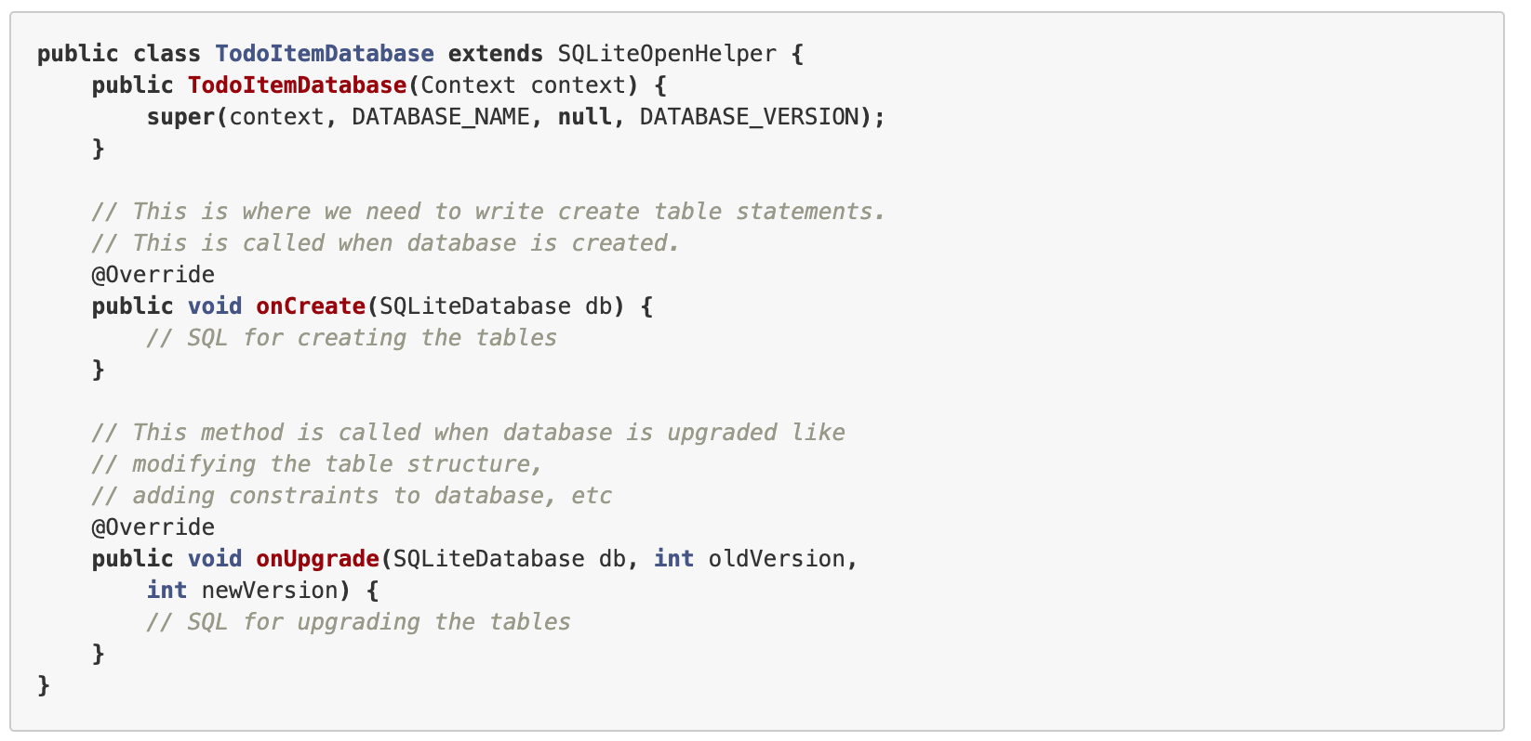
SQL Lite

Slide 12
Demo SQL Lite

Slide 13
#LifeKoKaroLift
Thank You!

